Slide 1
Lecture 4
System of Linear Equations

Slide 2
Objective:
Solve the system of linear equations to find the solution of the system.
Methodologies:
There are three commonly used methods to solve system of linear equations:
Using elementary row operations (Gaussian elimination and Gauss-Jordan elimination),
Using inverse matrix,
Cramer’s rule.

Slide 3
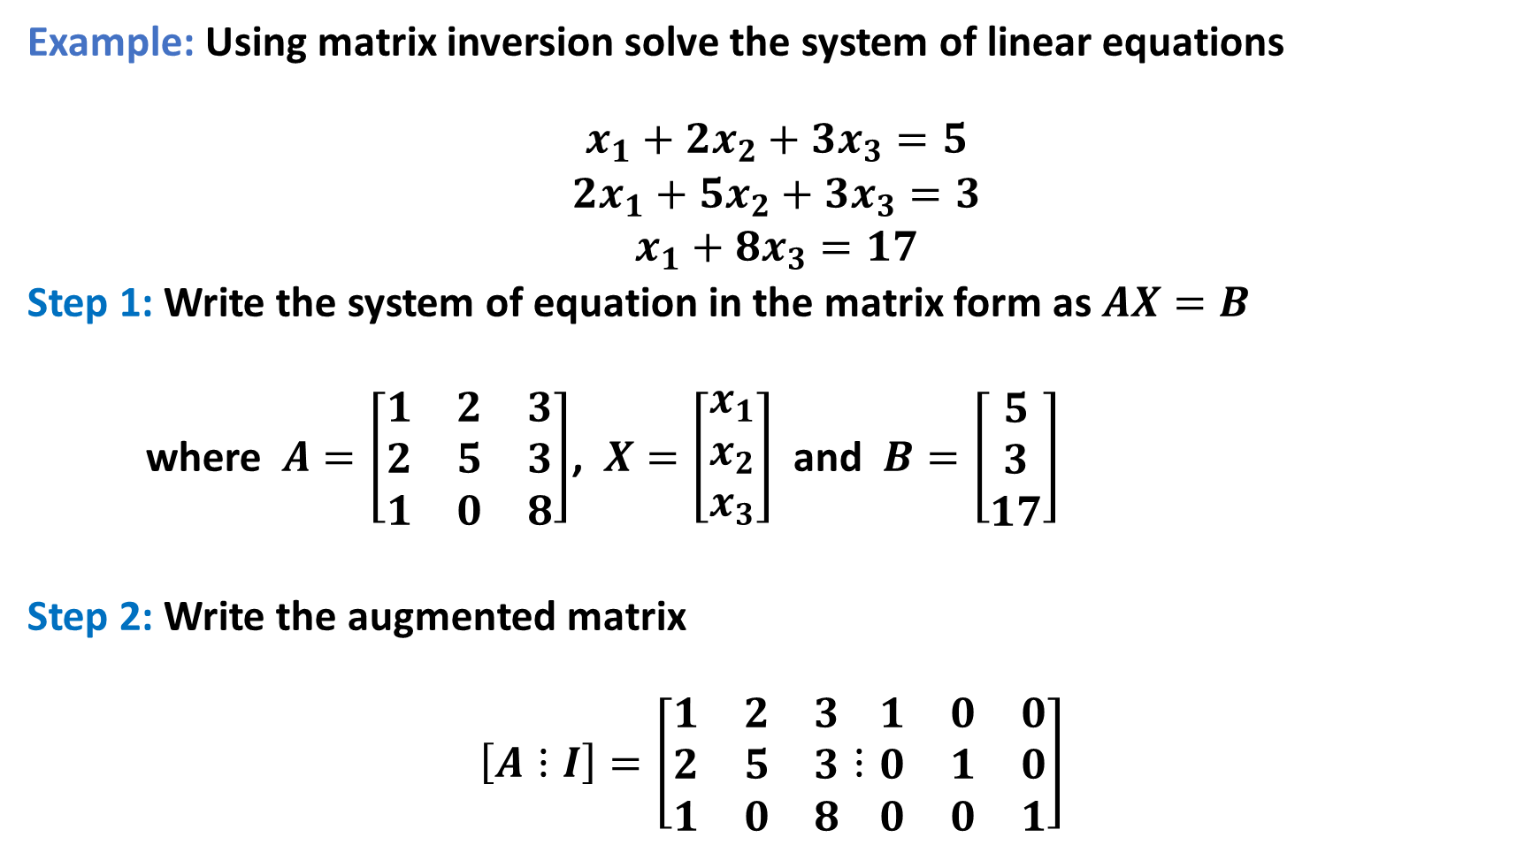
Example: Using matrix inversion solve the system of linear equations
$$\begin{matrix}x_{1}+2x_{2}+3x_{3}=5 \\ 2x_{1}+5x_{2}+3x_{3}=3 \\ x_{1}+8x_{3}=17\end{matrix}$$
Step 1: Write the system of equation in the matrix form as $AX=B$
where $A=\left[\begin{matrix}1 & 2 & 3 \\ 2 & 5 & 3 \\ 1 & 0 & 8\end{matrix}\right]$, $X=\left[\begin{matrix}x_{1} \\ x_{2} \\ x_{3}\end{matrix}\right]$ and $B=\left[\begin{matrix}5 \\ 3 \\ 17\end{matrix}\right]$
Step 2: Write the augmented matrix
$$\left[A⋮I\right]=\left[\begin{matrix}1 & 2 & 3 \\ 2 & 5 & 3 \\ 1 & 0 & 8\end{matrix}⋮\begin{matrix}1 & 0 & 0 \\ 0 & 1 & 0 \\ 0 & 0 & 1\end{matrix}\right]$$

Slide 4
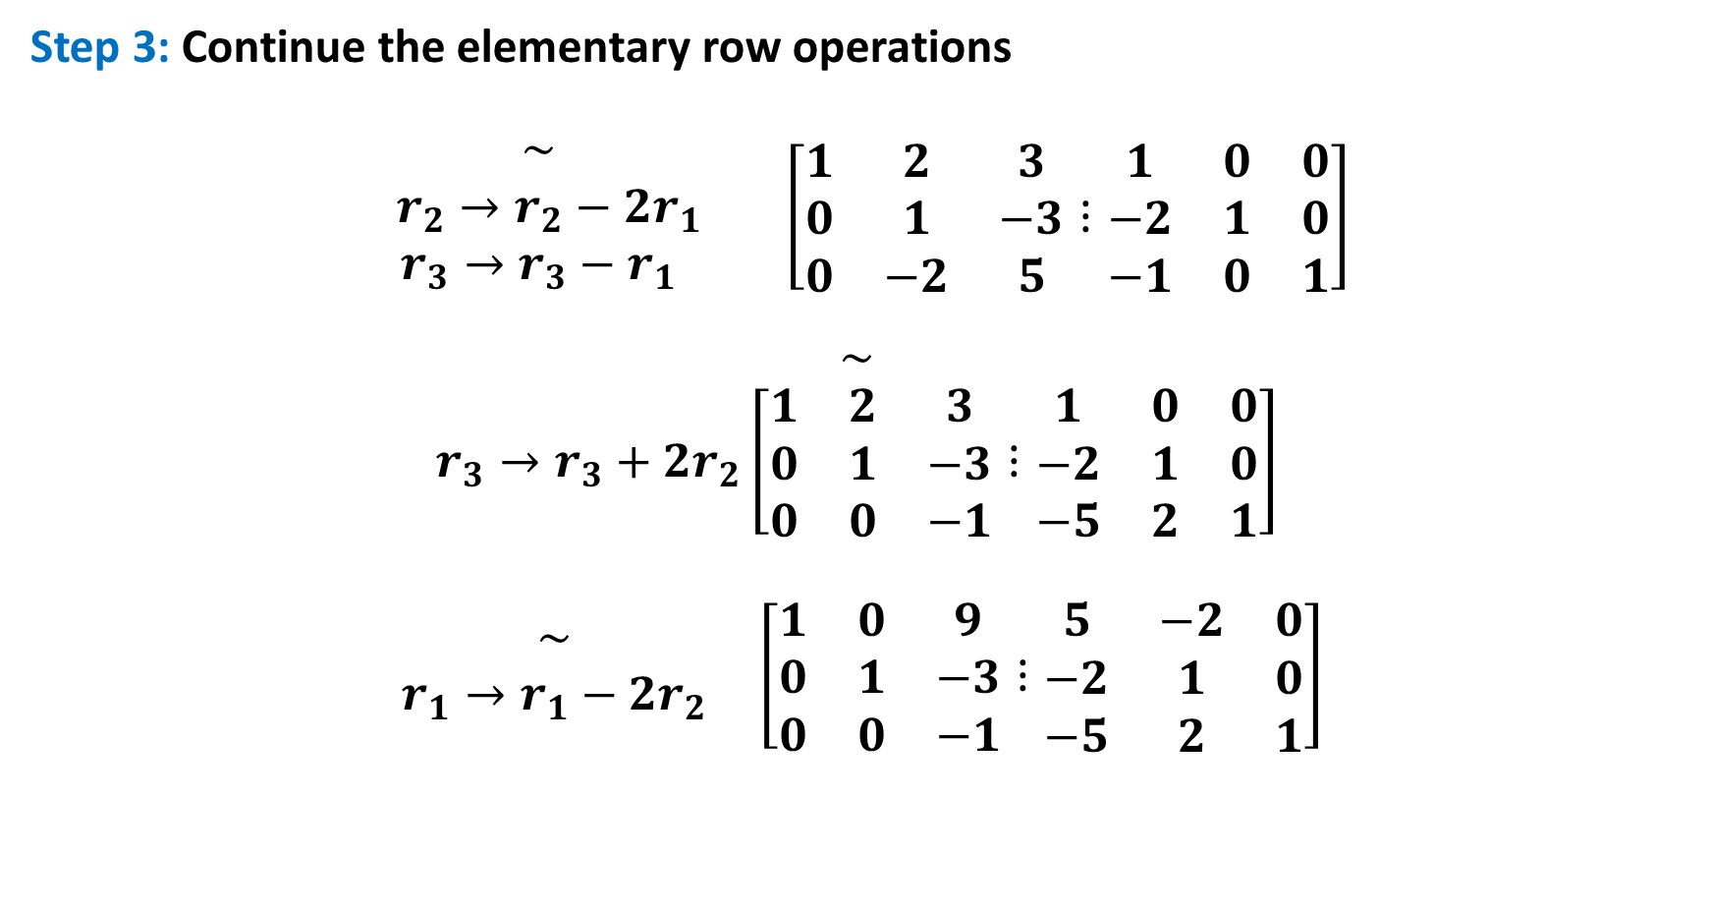
Step 3: Continue the elementary row operations
$$\begin{matrix}\sim \\ r_{2}→r_{2}−2r_{1} \\ r_{3}→r_{3}−r_{1}\end{matrix} \left[\begin{matrix}1 & 2 & 3 \\ 0 & 1 & −3 \\ 0 & −2 & 5\end{matrix}⋮\begin{matrix}1 & 0 & 0 \\ −2 & 1 & 0 \\ −1 & 0 & 1\end{matrix}\right]$$
$$\begin{matrix}\sim \\ r_{3}→r_{3}+2r_{2}\left[\begin{matrix}1 & 2 & 3 \\ 0 & 1 & −3 \\ 0 & 0 & −1\end{matrix}⋮\begin{matrix}1 & 0 & 0 \\ −2 & 1 & 0 \\ −5 & 2 & 1\end{matrix}\right]\end{matrix}$$
$$\begin{matrix}\sim \\ r_{1}→r_{1}−2r_{2}\end{matrix} \left[\begin{matrix}1 & 0 & 9 \\ 0 & 1 & −3 \\ 0 & 0 & −1\end{matrix}⋮\begin{matrix}5 & −2 & 0 \\ −2 & 1 & 0 \\ −5 & 2 & 1\end{matrix}\right]$$

Slide 5
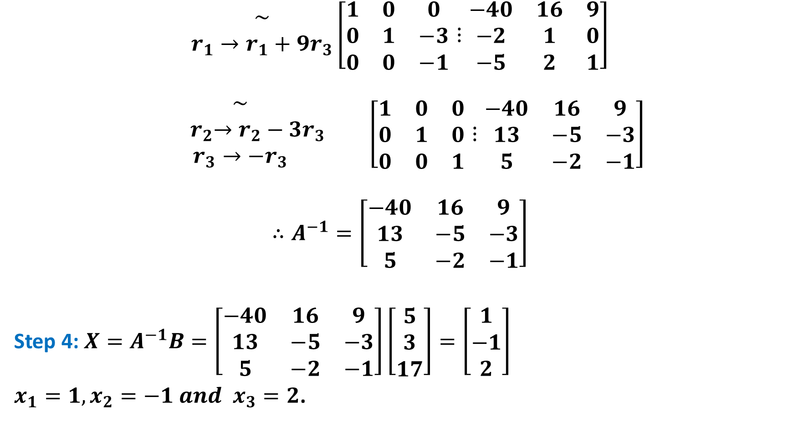
$$\begin{matrix}\sim \\ r_{1}→r_{1}+9r_{3}\end{matrix}\left[\begin{matrix}1 & 0 & 0 \\ 0 & 1 & −3 \\ 0 & 0 & −1\end{matrix}⋮\begin{matrix}−40 & 16 & 9 \\ −2 & 1 & 0 \\ −5 & 2 & 1\end{matrix}\right]$$
$$\begin{matrix}\sim \\ { r}_{2}→r_{2}−3r_{3} \\ r_{3}→{−r}_{3}\end{matrix} \left[\begin{matrix}1 & 0 & 0 \\ 0 & 1 & 0 \\ 0 & 0 & 1\end{matrix}⋮\begin{matrix}−40 & 16 & 9 \\ 13 & −5 & −3 \\ 5 & −2 & −1\end{matrix}\right]$$
$$∴A^{−1}=\left[\begin{matrix}−40 & 16 & 9 \\ 13 & −5 & −3 \\ 5 & −2 & −1\end{matrix}\right]$$
Step 4: $X=A^{−1}B=\left[\begin{matrix}−40 & 16 & 9 \\ 13 & −5 & −3 \\ 5 & −2 & −1\end{matrix}\right]\left[\begin{matrix}5 \\ 3 \\ 17\end{matrix}\right]=\left[\begin{matrix}1 \\ −1 \\ 2\end{matrix}\right]$
$x_{1}=1, x_{2}=−1 and x_{3}=2$.

Slide 6

Some related exercise:
$\begin{matrix} x+2y+4z =−13 \\ 3x− y+z=5 \\ x+3y =3\end{matrix}$
$\begin{matrix}3x+y+2z=14 \\ 2y+5z=22 \\ 2x+5y−z=−22\end{matrix}$
$\begin{matrix}−3x+2y−3z=−8 \\ 2x −y +z =4 \\ x +2y −4z=−2\end{matrix}$

Slide 7
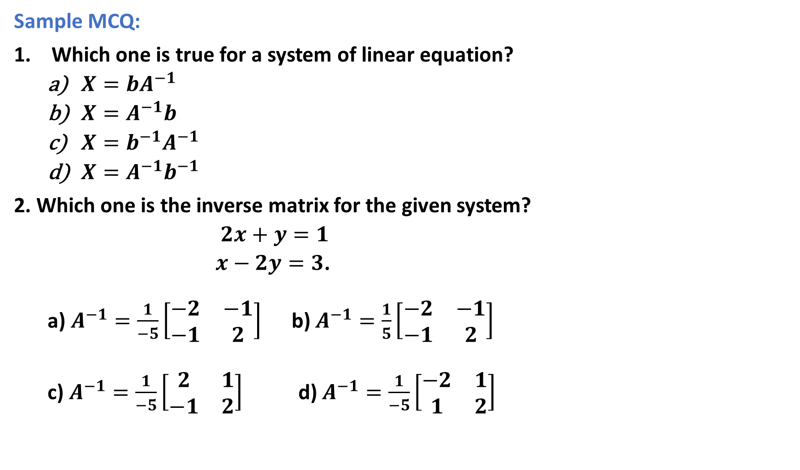
Sample MCQ:
Which one is true for a system of linear equation?
$X=bA^{−1}$
$X=A^{−1}b$
$X=b^{−1}A^{−1}$
$X=A^{−1}b^{−1}$
2. Which one is the inverse matrix for the given system?
$2x+y=1$
$x−2y=3$.
a) $A^{−1}=\frac{1}{−5}\left[\begin{matrix}−2 & −1 \\ −1 & 2\end{matrix}\right]$ b) $A^{−1}=\frac{1}{5}\left[\begin{matrix}−2 & −1 \\ −1 & 2\end{matrix}\right]$
c) $A^{−1}=\frac{1}{−5}\left[\begin{matrix}2 & 1 \\ −1 & 2\end{matrix}\right]$ d) $A^{−1}=\frac{1}{−5}\left[\begin{matrix}−2 & 1 \\ 1 & 2\end{matrix}\right]$

Slide 8
Outcome:
By applying Inverse-matrix method, system of linear equations can be solved to find the solution of the system.

